Slide 1
CAR Calibration Meeting CAR Review
AP Team
Jacky Wu, Catherine Qiu, Thomas Kestner
Nov 24, 2014

Slide 2
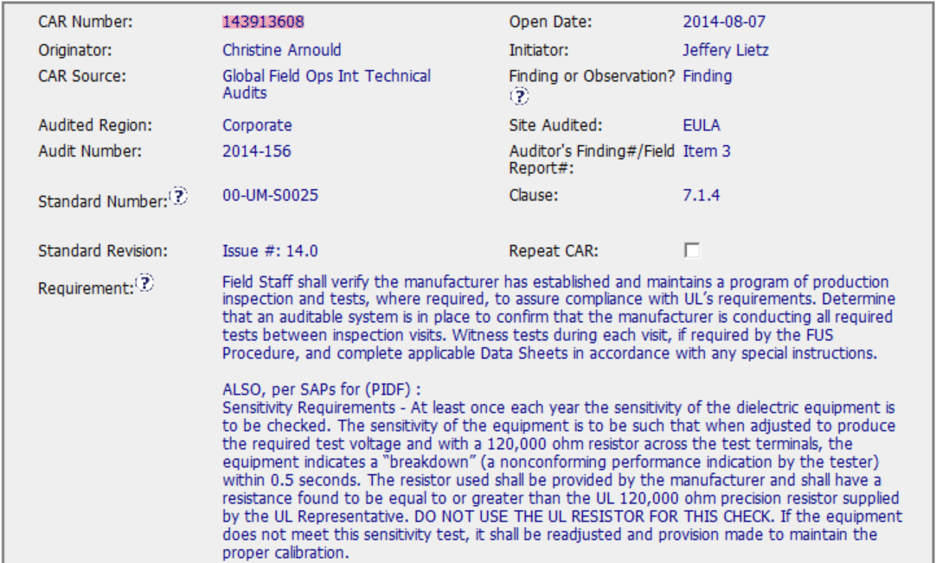
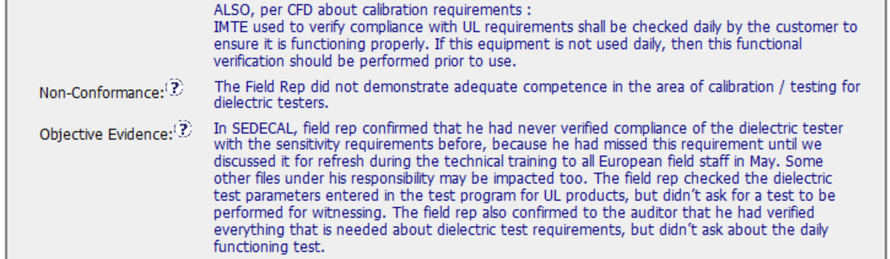
CAR 143913608 - Finding
More information could be included in the Objective Evidence, i.e. equipment number, Field Rep ID, production line number, inspection date, etc.
Then Non-Conformance can be stated in more clear that what competency was inadequate, i.e. Did not witness the required test and equipment verification.

Slide 3
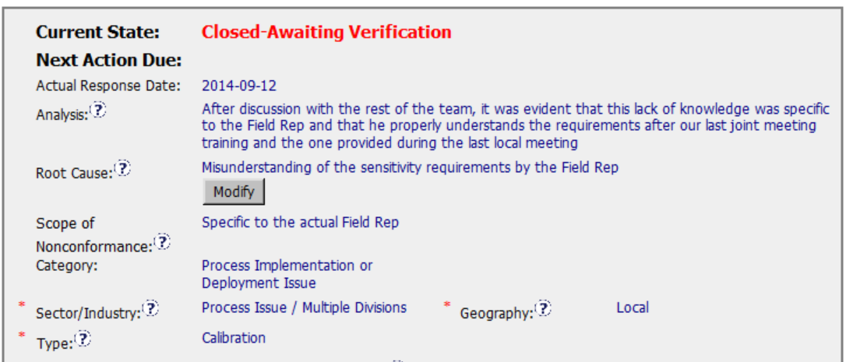
CAR 143913608 - Finding
The analysis is insufficient, more questions could be asked to find the root cause, e.g. Why it was due to lack of knowledge? Is it due to lack of training, or training ineffective, or other reasons? How did FOM verify the Field Rep’s competency and why it was not detected during the daily monitoring, etc.
In addition, how was the scope determined? More information should be provided to demonstrate that it was limited to the affected Field Rep only.
Human error (i.e. Field Rep’s misunderstanding”) should not be accepted as the root cause.
It should be “Factory Test (Field Services)” instead of “Calibration”

Slide 4
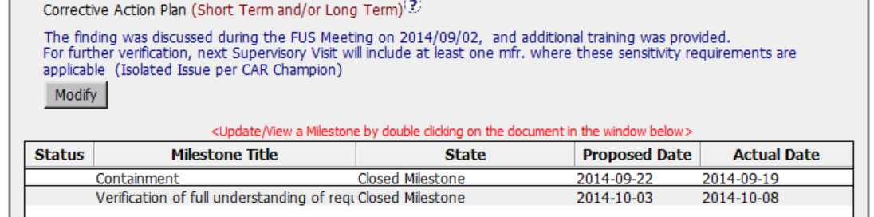
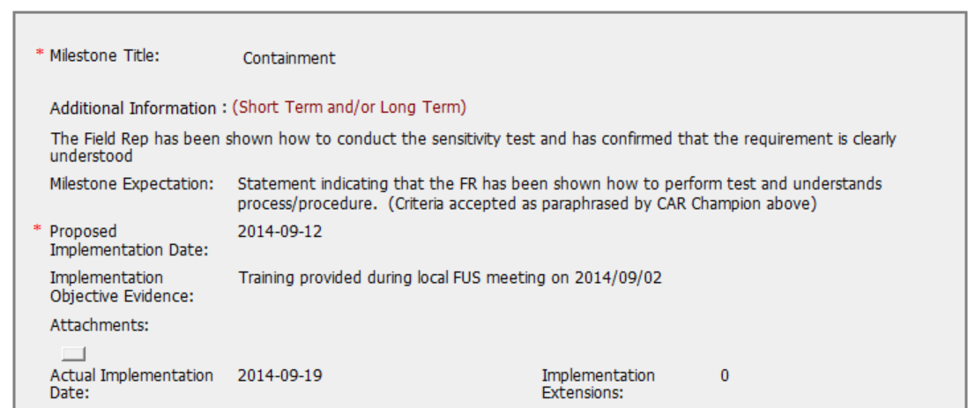
CAR 143913608 – Milestone 1
The containment action addressed in the milestone could not match the content addressed in the Corrective Action Plan, it was confused what was expected to be conducted for the containment action?
The Objective Evidence could not match the Milestone Expectation, i.e. Statement in IR vs Training?
In addition, there was no attached records to demonstrate what has been done.

Slide 5
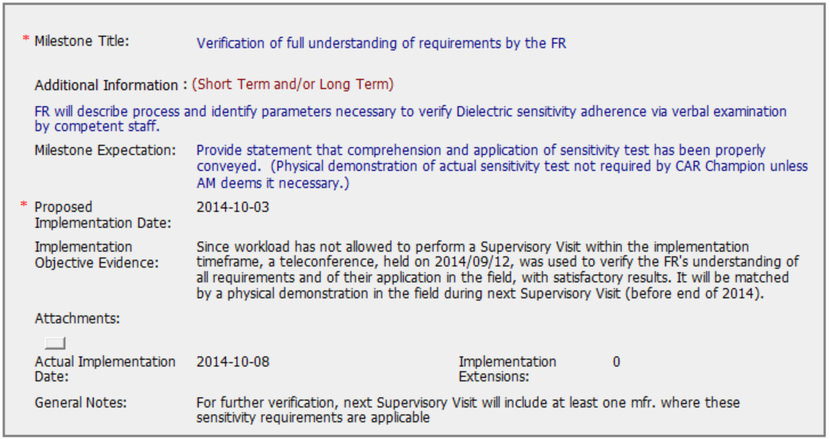
CAR 143913608 – Milestone 2
The milestone deviated from the description in the Corrective Action Plan. Since it was the on-site inspection issue, verbal examination is insufficient whether the Field Rep was competent to verify the test equipment and witness the Mfr’s testing. On-site verification (Supervisory Visit) is still needed.
As stated above, On-site verification (Supervisory Visit) is still needed. If there is insufficient resource to conduct the SV within the specific timeline, then additional milestone should be added.
In addition, since the root cause analysis was inadequate, additional short/long term action may be considered based on the rectified root cause analysis.

Slide 6
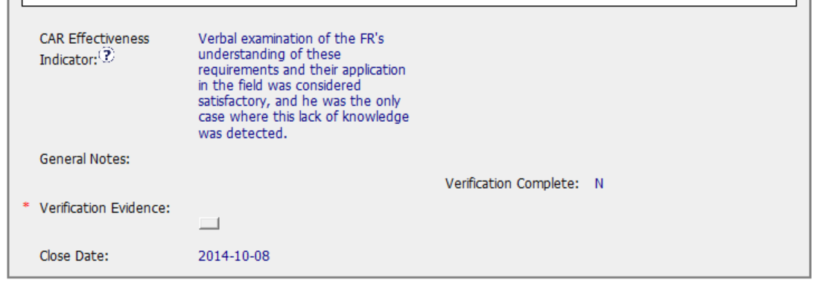
CAR 143913608 – Effectiveness Indicator
As stated above, since it was the on-site inspection issue, verbal examination is insufficient whether the Field Rep was competent to verify the test equipment and witness the Mfr’s testing. On-site verification (Supervisory Visit) is still needed.

Slide 7
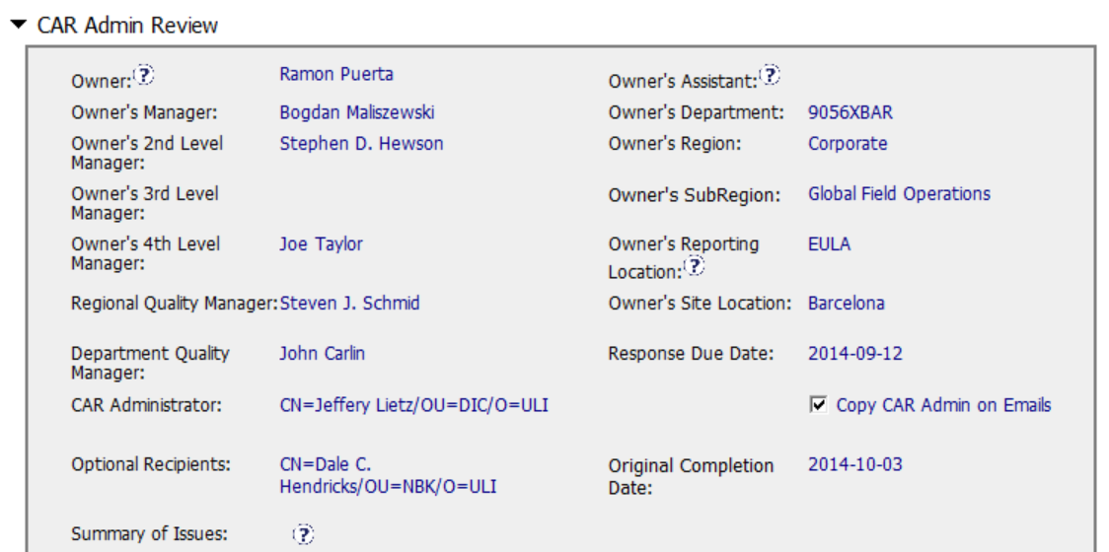
CAR 143913608 – Escalation Level
Correct

Slide 8
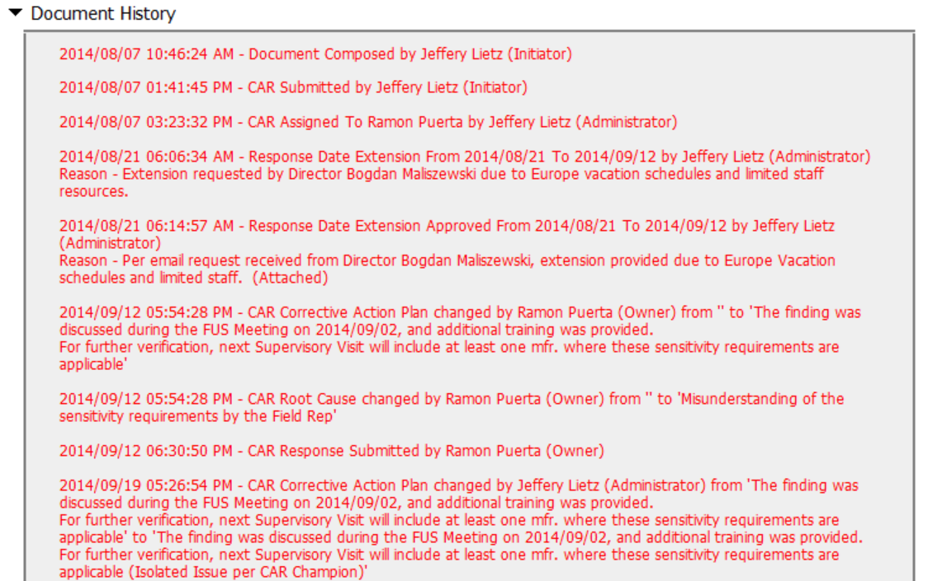
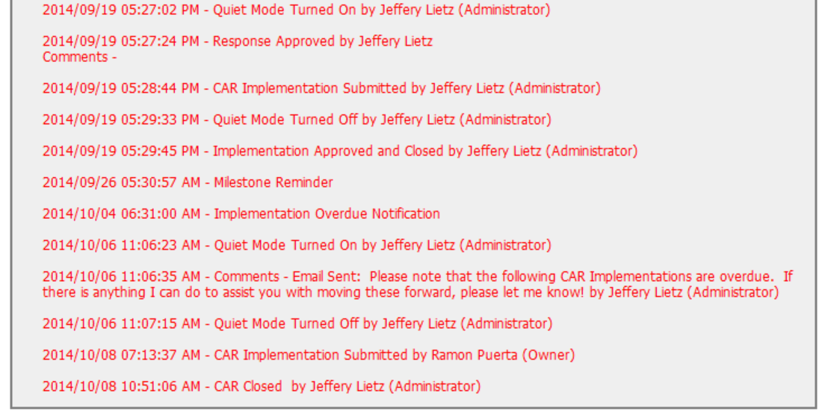
CAR 143913608 – History Study
The CAR Admin proactively help to extend the response date due the owner’s vacation.
The CAR Admin contacted the owner for the overdue issue. However, it could be improved that the CAR Admin could work with owner more closely before the due date and apply the extension earlier to avoid it’s overdue.

Slide 9
CAR 143913608 – CBS Check
CBS Requirements | Excellent | Moderate | Need Improve | N/A
(C) Extensions are within requirement (<30 days, 3 or less) | X
(T) Most appropriate ‘category’, ‘type’, ‘geography’ are selected |  |  | X
(P) Facilitates the handling of disputed CARs |  |  |  | X
(T) Acts on CARs within required timeframe |  | X
(C) Analysis shows clear path to root cause and scope; stakeholders identified |  |  | X
(C) Root cause statement is succinct, reasonable, complete (Shows ‘N/A’ for observations) |  |  | X
(C) Corrective actions fix the objective evidence and other problems found; address entire root cause and scope. For observations, they do not go beyond fixing the objective evidence |  |  | X
(C) Milestones address containment & owner’s verification; completed per milestone expectations |  |  | X
(P) Verification per requirements |  |  |  | X
(L) Referenced communications are attached as needed |  | X
(C L) Evidence of communication for overdue/escalated CARs and other pertinent concerns |  | X
(P) Trains other CAR Champions |  |  |  | X

Slide 10
CAR Review – December 2014 Dale – Chris – Jenni
143913608, 143913105, 143913946, 143913176

Slide 11
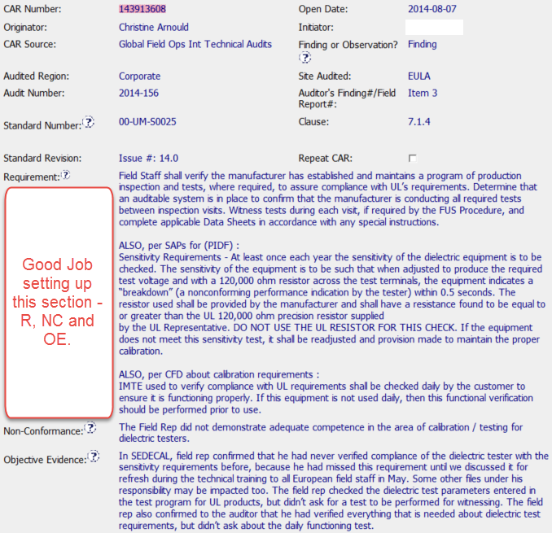
CAR 143913608 – Origination Section, Part 1

Slide 12
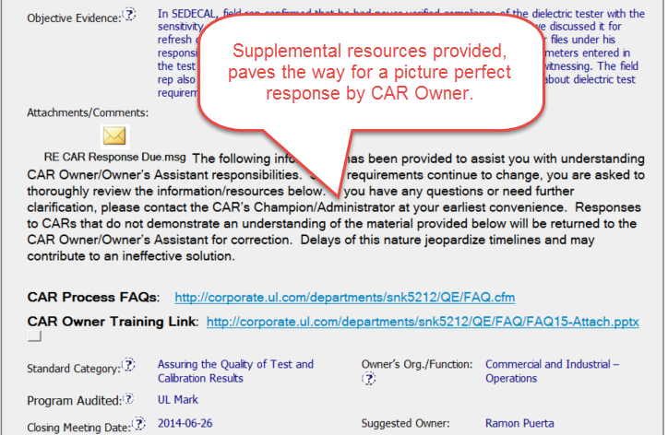
CAR 143913608 – Origination Section, Part 2

Slide 13
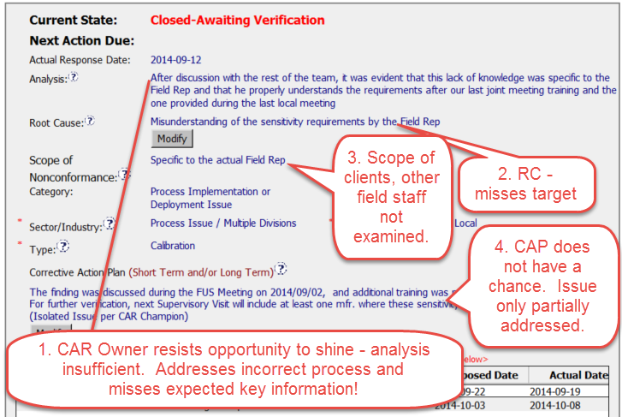
CAR 143913608 – CAR Owner Section

Slide 14
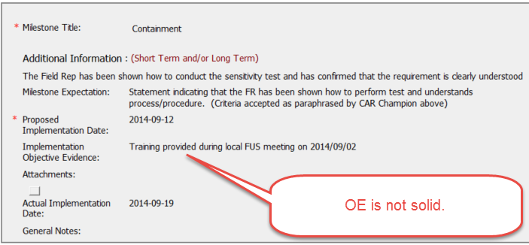
CAR 143913608 – CAR Owner Section, MS1

Slide 15
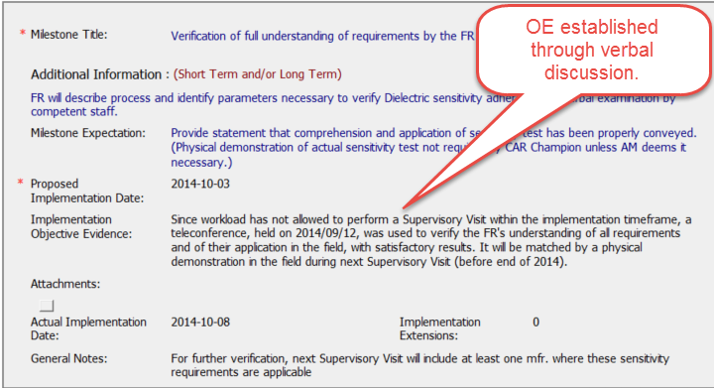
CAR 143913608 – CAR Owner Section, MS2

Slide 16
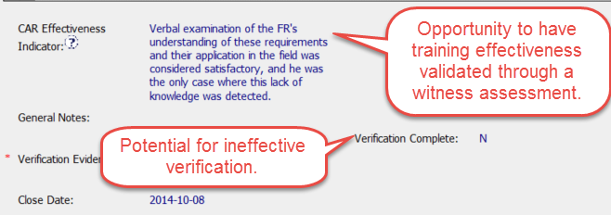
CAR 143913608 – CAR Owner Section, CEI

Slide 17
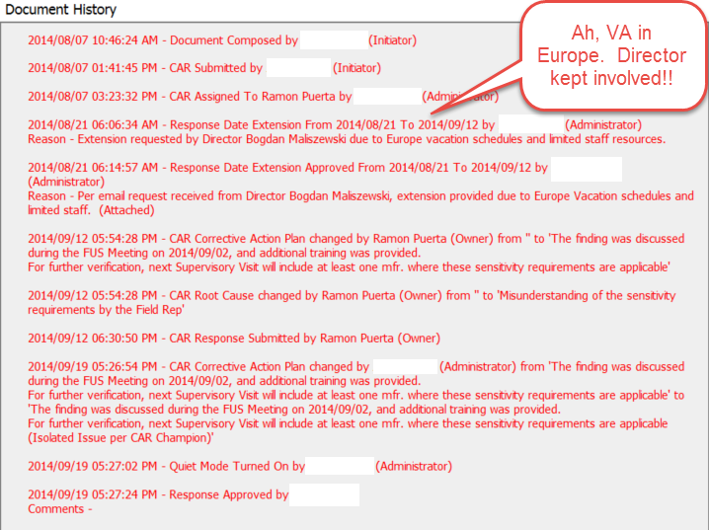
CAR 143913608 – CAR History

Slide 18
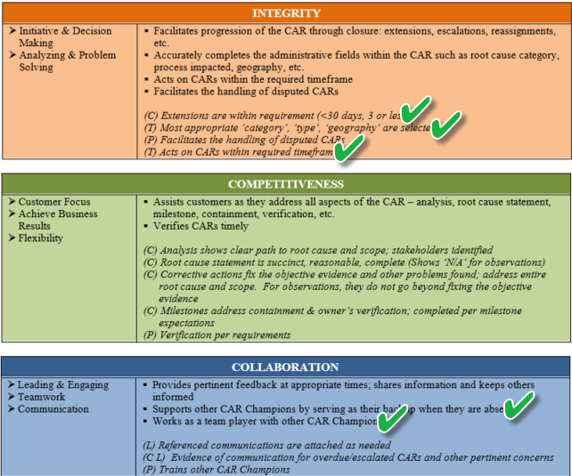
CAR Admin CBS’s

Slide 19
Exemplary - CAR 133912839 ?
December 2014

Slide 20
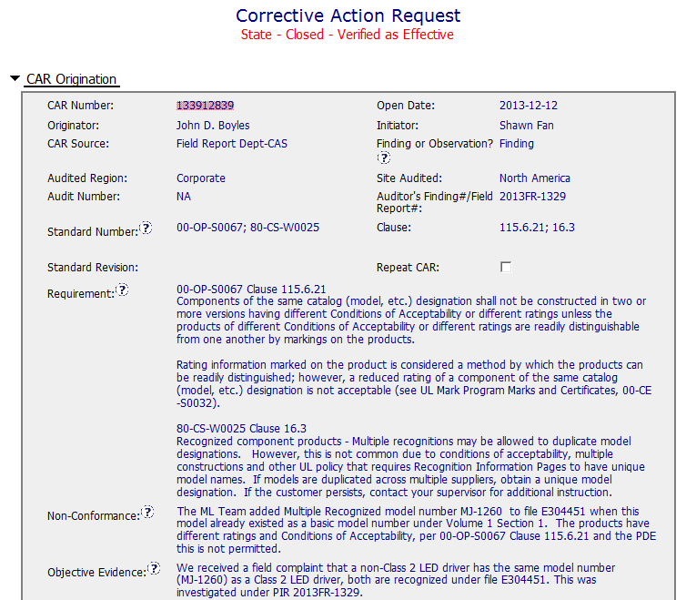
Exemplary - CAR 133912839 ?
CAR is well written with specific information

Slide 21
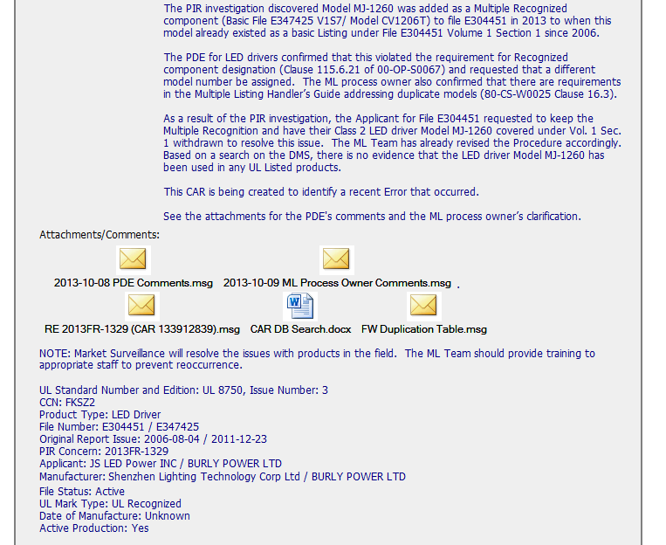
Exemplary - CAR 133912839 ?
PDE consulted
Supporting information provided

Slide 22
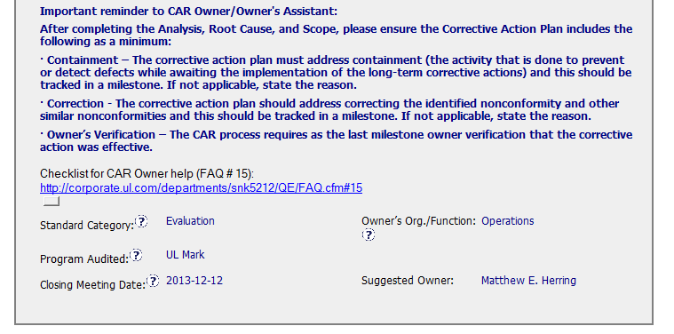
Exemplary - CAR 133912839 ?
Guidance provided
Links to relevant FAQs
Correct owner

Slide 23
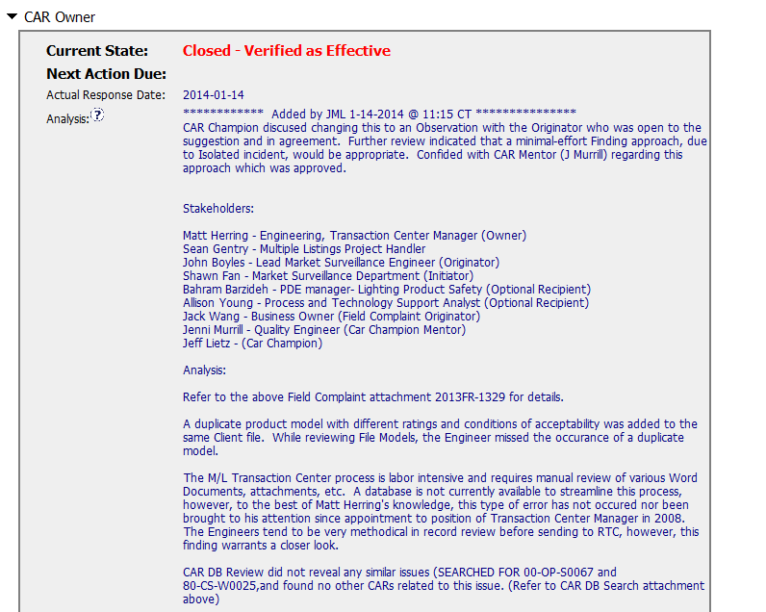
Exemplary - CAR 133912839 ?
Rationale notes included
Minimal effort-finding approach?
Stakeholders consulted

Slide 24
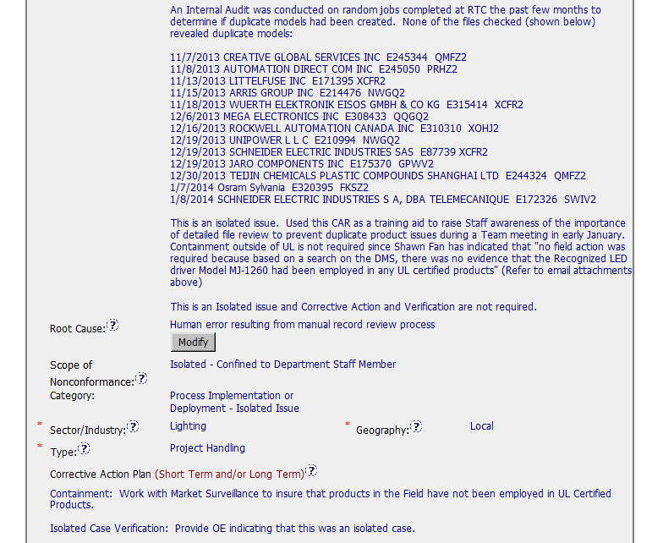
Exemplary - CAR 133912839 ?
Well scoped
Human error ?

Slide 25
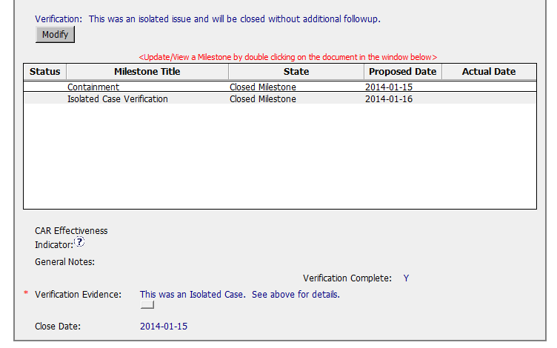
Exemplary - CAR 133912839 ?
May need to consider other ML handlers
Limitation of the CAR is scoping – may necessitate Root Cause revision and CA plan to be changed.

